Slide 1

BIGDATA
K.RAGUPATHIRAJA

Slide 2
Big data
Big data is the huge amount of data generating exponentially everyday and the size is increasing upto zetabytes of data
Bigdata cannot be stores in rdbms
Google invented gfs to store the data
Later it was derieved as hdfs

Slide 3
CONTENT
5V’S
HADOOP
YARN
MAPREDUCE
PIG
HIVE
SQOOP
FLUME

Slide 4
5v’s
1.volume : it refers the size of the data which is verylarge upto zetabytes of data
2.velocity: it refers to the speed at which new data is generated and it moves around.
3. veracity: it refers bias,noise and abmormality of data
Mainly due to storing the large amount of data.
4.variety: it refers the different types of data which is structured unstructured and semi structured data.
5.value: it refers the value extracted from the large amount of data.

Slide 5
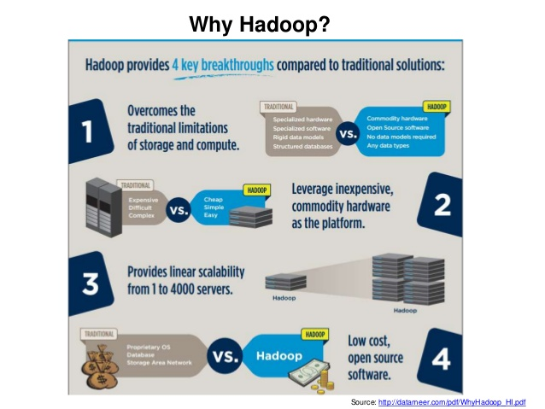

Slide 6
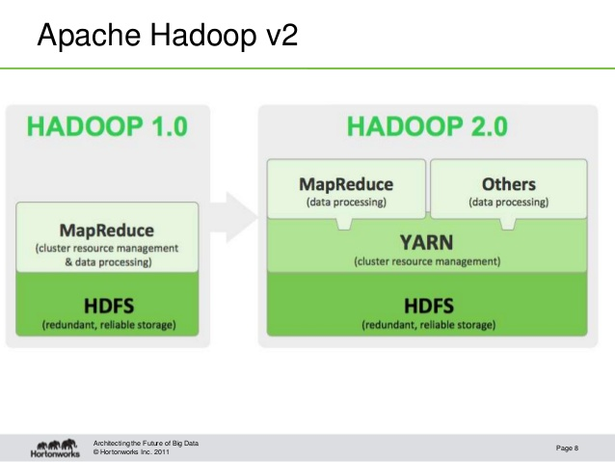

Slide 7
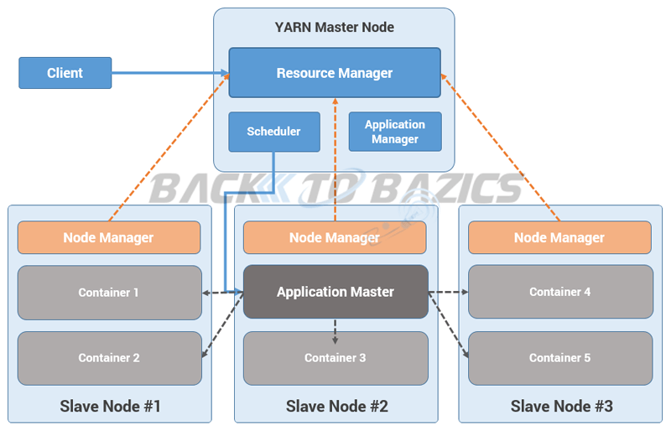

Slide 8
HDFS Architecture
Namenode
Metadata(Name, replicas..)
(/home/foo/data,6. ..
Metadata ops
Client
Block ops
Read
Datanodes
Datanodes
B
replication
Blocks
Rack1
Write
Rack2
Client
01/23/18

Slide 10
Advantage of yarn
Avoid single point of failure
Data availabilty
Rack awareness
Scalability
Fault tolerance

Slide 11
MAPREDUCE
Mapreduce jobs are done by using java programming
Language.
It has set of key and value pairs.
The mapreduce components are Mapper,Reducer,Driver.
Mappper phase generates set of key and value pairs.
Sort and shuffle phase will sort te keys in ascending order and shuffle the values
Reducer phase is the filter phase and executes the aggregated functions
Driver class is the main class that executes the mapper reducer phases.

Slide 12
MapReduce: The Reduce Step
Output
key-value pairs
Intermediate
key-value pairs
Key-value groups
reduce
k
v
k
v
v
v
k
v
reduce
k
v
k
v
v
k
v
group
k
v
…
…
…
k
v
k
v
k
v
E.g.
(word, wordcount-in-a-doc)
(word, list-of-wordcount)
(word, final-count)
~ SQL Group by
~ SQL aggregation
Adapted from Jeff Ullman’s course slides

Slide 13


Slide 14
ORDER OF MAPREDUCE
The order of mapreduce are
Input data-->blocks -->Input split->record reader->Mapper -> ->combiner->partitioner
->reducer->record writer

Slide 15
Pig
Pig is the high level data flow language
Provides the data flow
User can create their own function for special set of function
Pig components are grunt shell,pig latin ,pig server.
Supports avro format

Slide 16
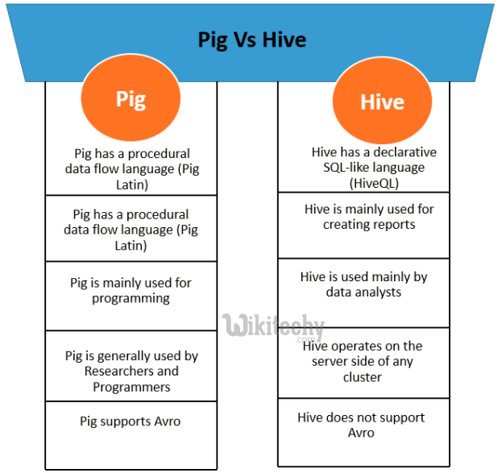
Pig

Slide 17
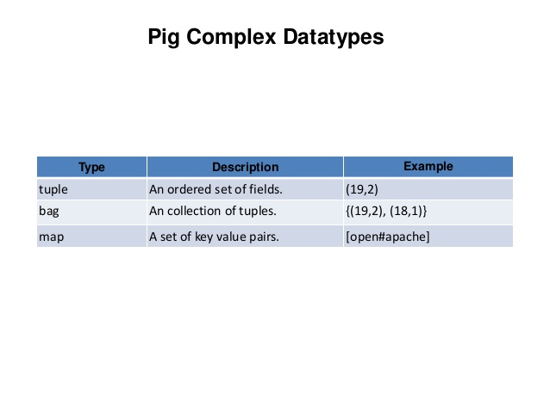

Slide 18
Hive
The Apache Hive ™ data warehouse software facilitates reading, writing, and managing large datasets residing in distributed storage using SQL. Structure can be projected onto data already in storage.
A command line tool and JDBC driver are provided to connect users to Hive.
Hive is used to process the structured data

Slide 19
sqoop
Sqoop is used to transfer the large amount of data from hdfs into sql.
Used to import and export data from hdfs into Rdbms

Slide 20
FLUME
Flume is a distributed, reliable, and available service for efficiently collecting, aggregating, and moving large amounts of log data. It has a simple and flexible architecture based on streaming data flows.
It is robust and fault tolerant with tunable reliability mechanisms and many failover and recovery mechanisms. It uses a simple extensible data model that allows for online analytic application.

Slide 21
H1b visa
The H1B is an employment-based, non-immigrant visa category for
temporary foreign workers in the United States. For a foreign national to apply for H1B visa,
an US employer must offer a job and petition for H1B visa with the US immigration
department. This is the most common visa status applied for and held by international students
once they complete college/ higher education (Masters, Ph.D.) and work in a full-time
position

Slide 22
Thank you

Slide 24
a) Is the number of petitions with Data Engineer job title increasing over time?
Step1 :The concept of Mapper and Reducer is used here. The data set has numerous columns but the columns which we need to solve the problem are Year and entire value. Hence the Year column is passed as the key and the entire value is passed as the count.
Step 2: Now before generating the mapper output the required records can be filtered with the condition that Job Title is equal to Data Engineer, this will help in reducing the number of records that go into the reducer.
Step 3: Then in the reducer a simple counting operation is done and the results are displayed. And the results will be sorted based on the key which is the year and hence the year is in increasing order and so is the number of applicants

Slide 25
b) Find top 5 job titles who are having highest avg growth in applications.[ALL]
In pig the query is solved by proceeding with bags and loading and processing data in them. In the first step the cleansed data is loaded into a bag.
Step 2: Then the bag is filtered year wise and then stored together in another bag.
Step 3: Then the progressive growth formula is applied.
Step 4: The average progressive growth is found out and the result is ordered in descending order and printed.

Slide 26
2 a) Which part of the US has the most Data Engineer jobs for each year?
The cleaned dataset is grouped by year and worksite
find only the Data Engineer applicants and year is specified from 2011 to 2016 individually as a condition.
The output is printed in descending order of the count total and the top value is printed.

Slide 27
2b find top 5 locations in the US who have certified visa for each year. [certified]
Step1: loading the cleansing data as input file in mapper phase
Step2: worksite as key and entire value as value with tab separated are passed as reduced input
Step 3: partioned is done based on yearwise.
Step 4: count operation is performed based on certified and dataengineer jobs
Step 5: the result are stored in tree map
Step 6: removing the firstkey till the size reaches the last one to get the top value.

Slide 28
3.)Which industry(SOC_NAME) has the most number of Data Scientist positions?
[certified]
The cleansed data is grouped by soc_name and job title and conditions are applied to filter CERTIFIED case status and DATA SCIENTIST jobs.
Code: select soc_name,job_title,count(*)as total from h1b_final where case_status="CERTIFIED" and job_title="DATA SCIENTIST" group by soc_name,job_title order by total desc limit 1;

Slide 29
Which top 5 employers file the most petitions each year? - Case Status – ALL
Step1: loading the cleansing data as input file in mapper phase
Step2: employer as key and entire value as value with tab separated are passed as reduced input
Step 3: partioned is done based on yearwise.
Step 4: count operation is performed based on employer name file the petitions.
Step 5: the result are stored in tree map
Step 6: removing the firstkey till the size reaches the last five to get the top 5 value.

Slide 30
5) a) Find the most popular top 10 job positions for H1B visa applications for each year? for all the applications
The cleancing data are grouped by year,jobtitle and count the job title.
Arrange the data in descending order and limit 10.
Code : select year, job_title, count(job_title) as n from project.h1b_final where year=$year group by year, job_title order by n desc limit 10;

Slide 31
5) b) Find the most popular top 10 job positions for H1B visa applications for each year? For only certified applications.
The cleancing data are grouped by year,jobtitle filter case status by certified aplication and count the job title.
Arrange the data in descending order and limit 10.
Code:
select year,job_title,count(job_title) as count from h1b_final where year=$year,case_status='CERTIFIED' group by year and job_title order by count desc limit 10;

Slide 32
6) Find the percentage and the count of each case status on total applications for each year. Create a line graph depicting the pattern of All the cases over the period.
Step 1: In pig the query is solved by proceeding with bags and loading and processing data in them. In the first step the cleansed data is loaded into a bag.
Step 2: Then the bag is grouped year wise and then stored together in another bag. And count operation is performed in another.
Step 3: Then another bag is grouped year and case status wise and then strored together in another bag. And count operation is performed in another.
Step 4: Then the above two bags are joined, and the percentage formula is applied and the required results are generated.

Slide 33
h1b_final = load '/user/hive/warehouse/project.db/h1b_final/*' using PigStorage('\t') as (sno:int, case_status:chararray, emp_name:chararray, soc_name:chararray, job_title:chararray, full_time_pos:chararray, wage:long, year:chararray, worksite:chararray, longitude:double, lattitude:double);
year_grp = group h1b_final by $7;
total = foreach year_grp generate group, (float)COUNT(h1b_final.$1) as tot;
--dump total;
grpm = group h1b_final by ($7,$1);
case_total = foreach grpm generate flatten(group), (float)COUNT(h1b_final.$1) as percent;
--dump case_total;
join_grp = join total by $0,case_total by $0;
--dump join_grp;
final = foreach join_grp generate $0,$3,$4,ROUND_TO(($4/$1)*100,2);
dump final;
--store final into '/home/hduser/Documents/project pig querries/project6';

Slide 34
7) Create a bar graph to depict the number of applications for each year [All]
Step 1: The concept of Mapper and Reducer is used here. The data set has numerous columns but the columns which we need to solve the problem are Year and entire values. Hence the Year column is passed as the key and the Sl.nois passed as the count.
Step 2: Then in the reducer a simple counting operation is done and the results are displayed. And the results will be sorted based on the key which is the year and hence the year is in increasing order and so is the number of applicants.

Slide 35
8) Find the average Prevailing Wage for each Job for each Year (take part time and full time separate). Arrange the output in descending order - [Certified and Certified Withdrawn.]
The cleaned dataset is grouped by year, job title and full time position
apply where condition to find only the CERTIFIED AND CERTIFIED-WITHDRAWN applicants and year is specified from 2011 to 2016 individually as a condition and so is the full time position .
The output is printed in descending order of the count total and the top value is printed.
Code:
select year,job_title,full_time_position,avg(prevailing_wage)as average from h1b_final where year=$variable and full_time_position="$variable" and (case_status="CERTIFIED" or case_status="CERTIFIED-WITHDRAWN") group by year,job_title,full_time_position order by average desc;

Slide 36
9) Which are the employers along with the number of petitions who have the success rate more than 70% in petitions. (total petitions filed 1000 OR more than 1000)?
Step 1: In pig the query is solved by proceeding with bags and loading and processing data in them. In the first step the cleansed data is loaded into a bag.
Step 2: Then the bag is grouped based on employer name and then stored together in another bag. And count operation is performed in another.
Step 3: Then another bag is grouped based on employer name but with filtered data of certified and certified withdrawn case statuses and case status wise stored in another bag. And count operation is performed in another.
Step 4: Then the above two bags are joined, and the success rate formula is applied and the required results are generated.

Slide 37
10) Which are the job positions along with the number of petitions which have the success rate more than 70% in petitions (total petitions filed 1000 OR more than 1000)?
Step 1: In pig the query is solved by proceeding with bags and loading and processing data in them. In the first step the cleansed data is loaded into a bag.
Step 2: Then the bag is grouped based on job positions and then stored together in another bag. And count operation is performed in another.
Step 3: Then another bag is grouped based on employer name but with filtered data of certified and certified withdrawn case statuses and case status wise stored in another bag. And count operation is performed in another.
Step 4: Then the above two bags are joined, and the success rate formula is applied.

Slide 38
Code

Slide 39
